Slide 1

CPE 490 Embedded Systems Lecture 18
FreeRTOS
Task communication through a queue
Binary and Counting Semaphores
Much of this presentation comes from www.freertos.org tutorial
As well as “Using the FreeRTOS Real Time Kernal, A Practical Guide”, Richard Barry, 2010 version 1.3.2.

Slide 2
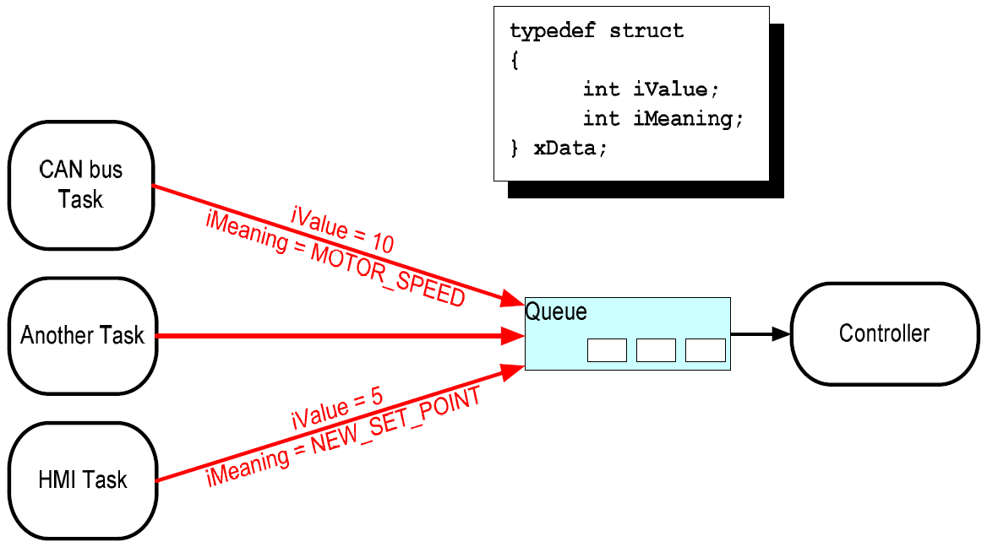
A Real Example
Notes:
It is a common pattern to have multiple messages coming into one controller that is made to act on messages. The controller is the primary responsible for system function.
When this pattern occurs it is necessary for the controller to know the author of the data that it is action upon. A structure can made so that both the author and the message can be decoded. In addition if sequence of events is important at timestamp could be given.
In this new example based upon the above drawing the writing tasks will have a higher priority than the controller task. This does not have to happen this way. The meaning of that priority assertion is that the writing tasks will fill up the queue until they block themselves then the controller task at a lower priority will run.

Slide 3
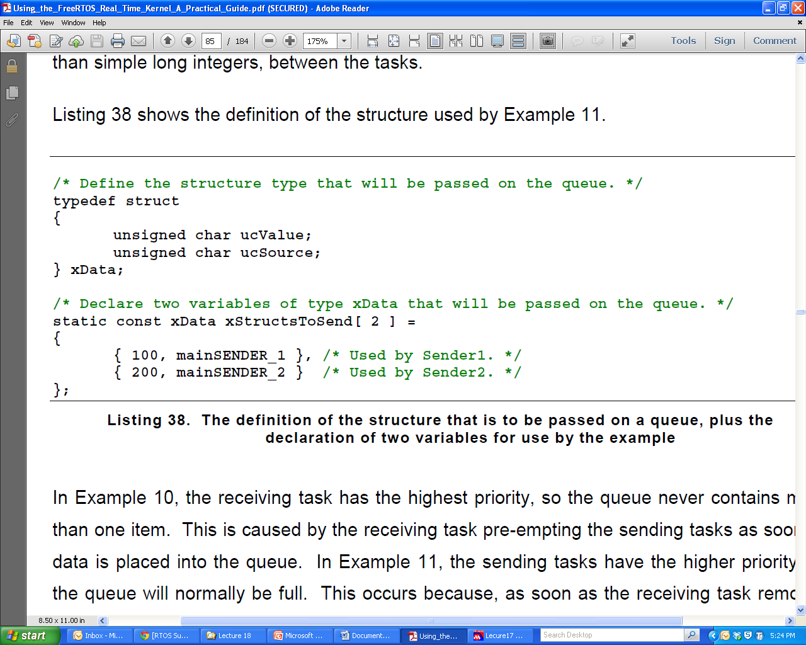
Defining a Structure for Queue Data
Notes:
Remember typedef type new_name; Therefore XData is a type not an instance
const – The value of the variable can never change
static – In the case of a global variable it means the scope of the global variable is only in this file and is not available in other files.

Slide 4
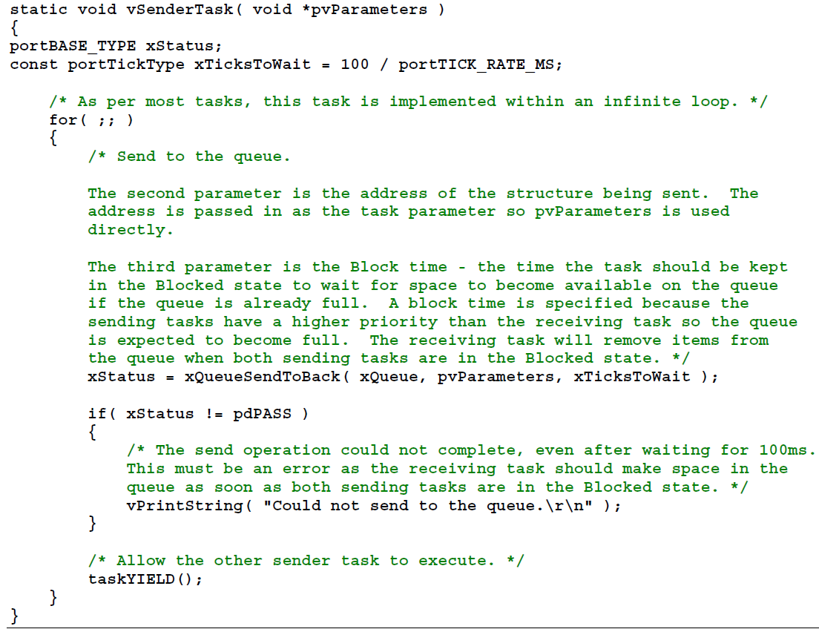
Tasks Writing the Queue
Notes:
Using the send to the back uniformly will cause FIFO
Since 100 ms of block time is used to wait the String can only be printed if the block time expires before a free space in queue occurs.

Slide 5
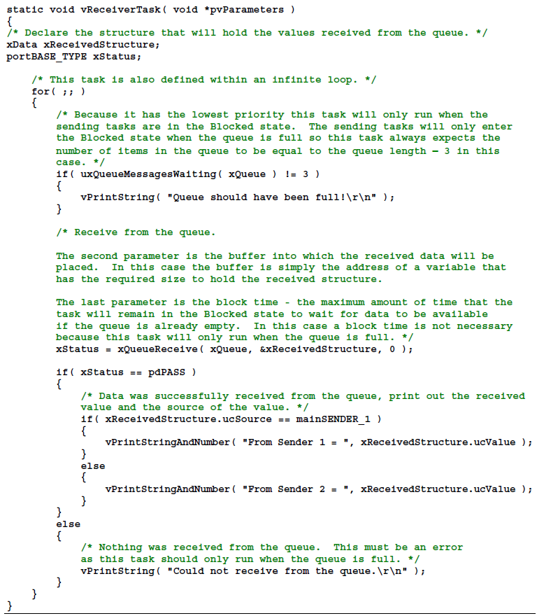
Control Task Reading the Queue
Since Lower priority should always be true
Notes:
Remember Xdata is the struct that is defied a couple of slides ago.

Slide 6
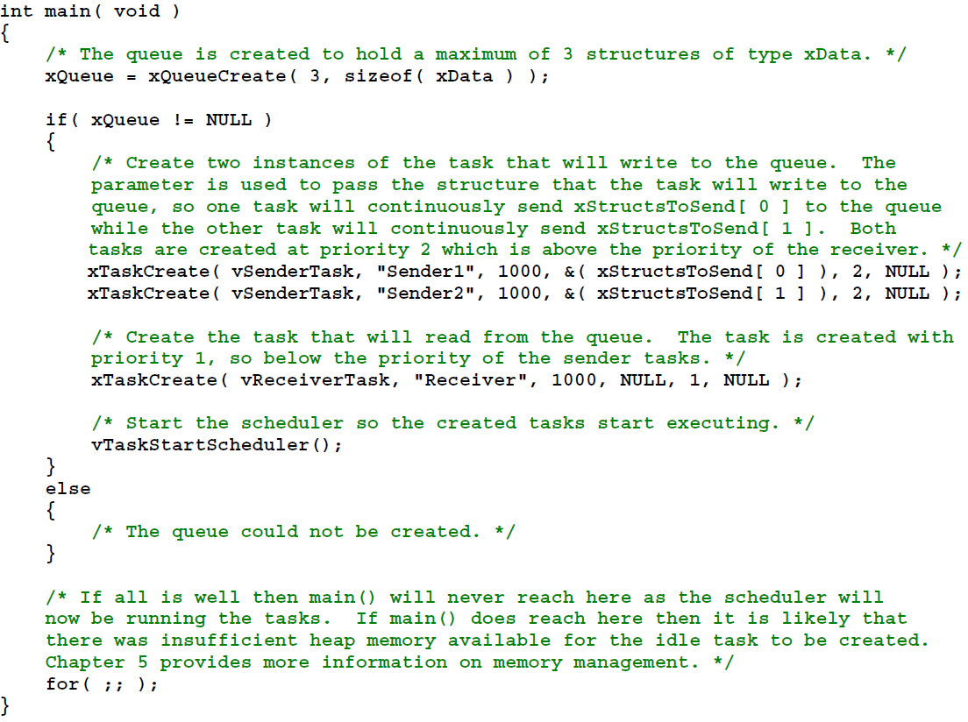
Notes:
Creation of Queue and Tasks
The sizeof C operator ‘runs’ at compile time
Notice the priorities

Slide 7
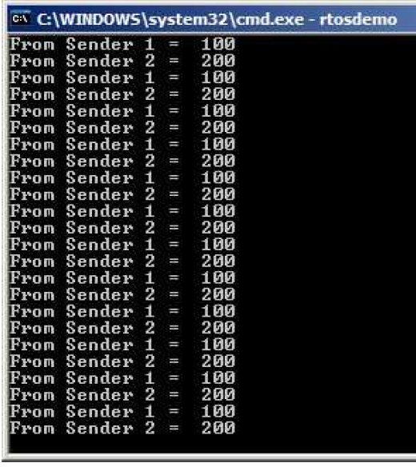
Example Output

Slide 8
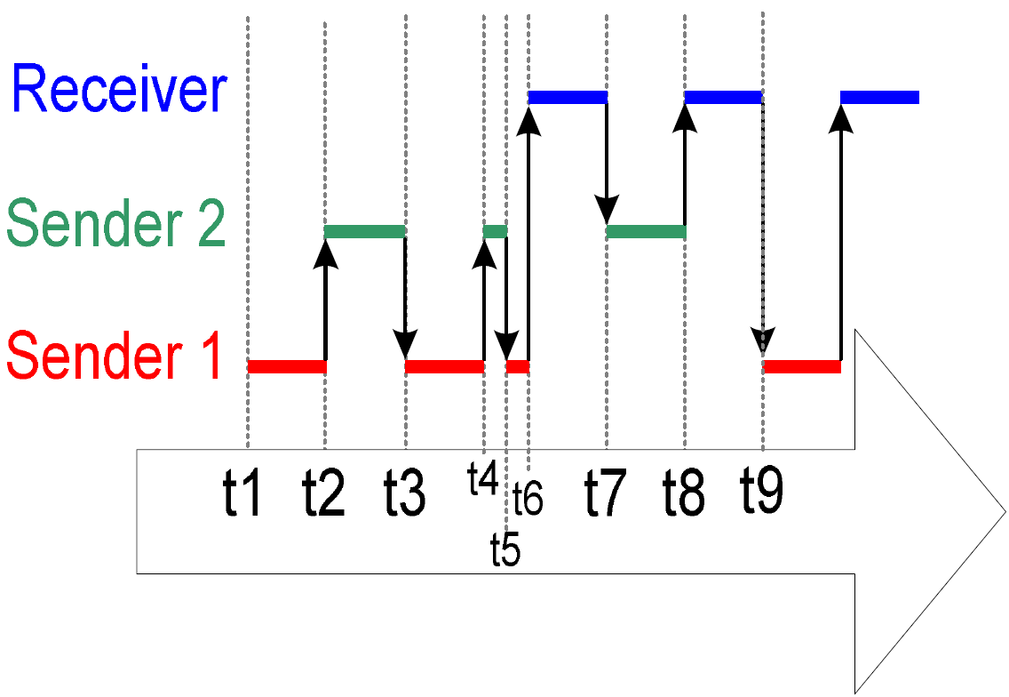
Sequence of Execution for Example
Notes:
T1 Task sender 1 is first called, it writes a value to the queue and then yields to other tasks T2 Since sender 2 task is in the ready state and of equal priority to sender 1 it now will run, writing to the queue one value also and then yielding T3 Since sender 1 task only yielded and not blocked it will now execute. It writes the third value to the queue, filling it, at this point and yielding the process once more T4 Since Sender 2 has only yielded and not blocked it is in the ready state and is now running. It will attempt to write to the queue but will fail because the queue is full and thus block itself for 100 ms or that the queue opens. Which ever happens first T5 Since Sender 1 yielded last time it is ready and now begins to execute. At this point it will try to write the queue, fail and block itself for 100 ms or empty queue space. T6 at this point both priority 2 tasks are blocked so the Receiver task runs, it will go ahead and read a value from the queue. As soon as it does the receiver task will preempted because now Sender2 is unblocked and of higher priority. T7 Sender 2 will now fill the queue again with a write and then yield. But the queue is full so Sender 1 remains blocked and Sender 2 will go to the running state again. Sender 2 will try to write the queue but it is now full so it will block itself for up to 100 ms. T8 The only process not blocked is the Receiver task so it will now read the queue again. As soon as it does the queue has space and Sender 1 is now unblocked. T9 Sender 1 will now write to the queue filling it and then executing the yield function. Since Sender 2 is still blocked Sender 1 will become running again, it will try to write to the queue but fail and again block itself for up to 100 ms. At this point both sender tasks are blocked and the receiver task will become running.

Slide 9
Synchronizing with External Events
Usually this is the realm of interrupts
But.. How much processing should be done in the ISR?
How will the RTOS help me communicate information from the ISR?

Slide 10
Binary Semaphore
Can be used to unblock a task each time a particular interrupt occurs. If the unblocked task is of high priority it will run immediately.
This allows the ISR to be very short but still trigger a task very quickly after the event has occurred.
The interrupt processing is said to have been ‘deferred’ to a ‘handler’ task.

Slide 11
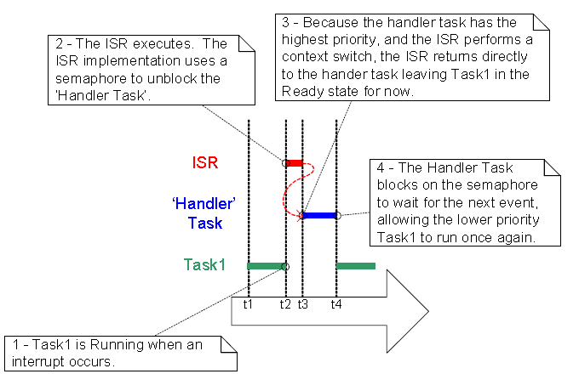
Using Interrupt to Preemptively Change Tasks

Slide 12
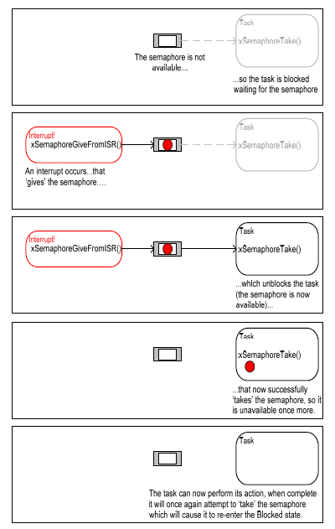
Example of a Semaphore
Think like a queue of length = 1 (binary)
To Give is to put a ‘value’ into the queue
To Take is read a ‘value’ from the queue

Slide 13
Create a Semaphore
Prototype:
void vSemaphoreCreateBinary( xSemaphoreHandle xSemaphore);
xSemaphore is of type xSemaphoreHandle
The following was found in semphr.h
typedef xQueueHandle xSemaphoreHandle;
The followin was found in queue.h
typedef void * xQueueHandle;
Notes:
It appears that a pointer to an integer should be passed to the creating API call.

Slide 14
Taking or Obtaining a Semaphore
Prototype
portBASE_TYPE xSemaphoreTake( xSemaphoreHandle xSemaphore, //unique id portTickType xTicksToWait); // time to wait //without semaphore being given before //unblocking
Return Value pdPASS if before the wait time expires that semaphore is taken
Return Value pdFALSE if the semaphore is not available before wait time.
Notes:
As before if xTicksToWait is 0 then return immediately without blocking
If xTickToWait is set to portMAX_DELAY then wait forever for semaphore to be given

Slide 15
Giving a Semaphore
Prototype
portBASE_TYPE xSemaphoreGiveFromISR( xSemaphoreHandle xSemaphore,//unique id
portBASE_TYPE *pxHigherPriorityTaskWoken); //This is a pointer to a variable. This API call will set this to pdTRUE if a equal or higher priority task is enabled.
Return pdPASS if semaphore given, pdFAIL if it can not give it .
Notes:
In order for preemption to occur you must execute an API like portSWITCH_CONTEXT. This will be based on what value is written to *pxHigherPriorityTaskWoken.

Slide 16
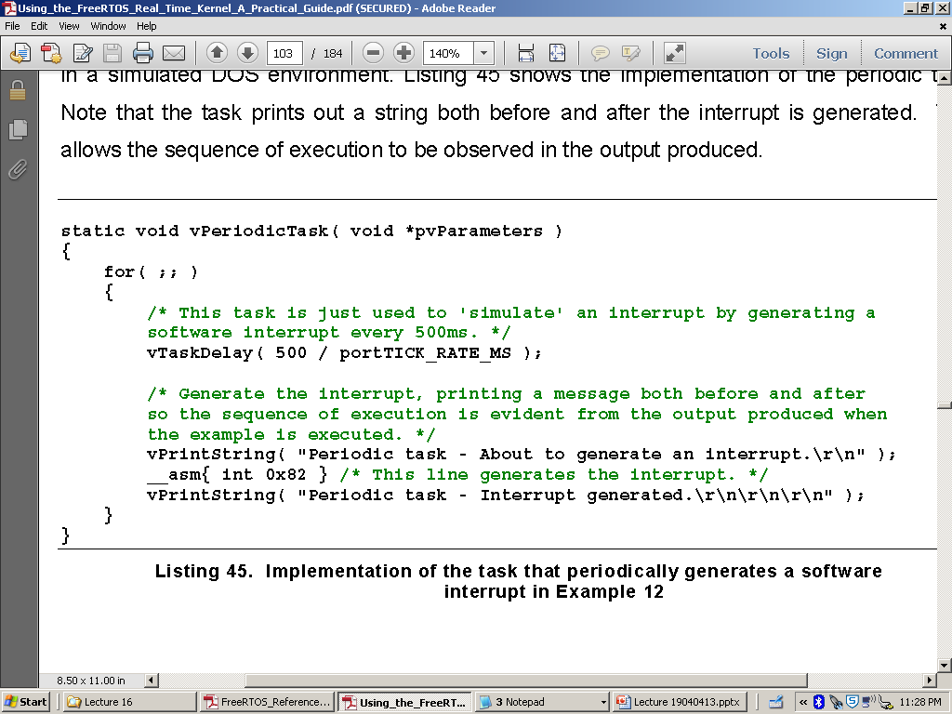
Binary Semaphore Example

Slide 17
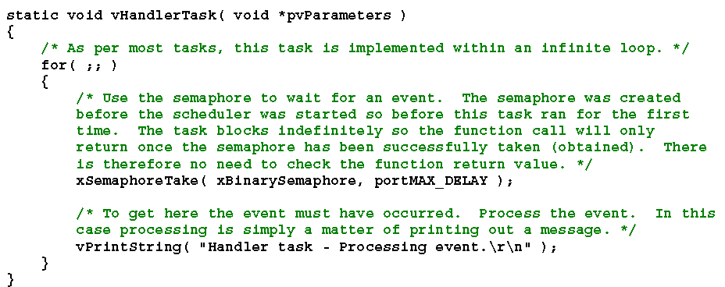
Example Handler Task

Slide 18
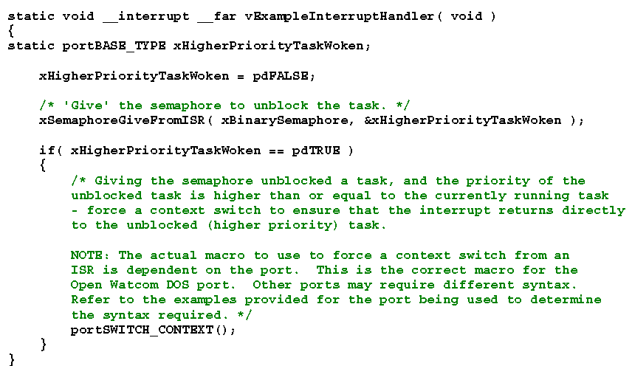
Example ISR

Slide 19
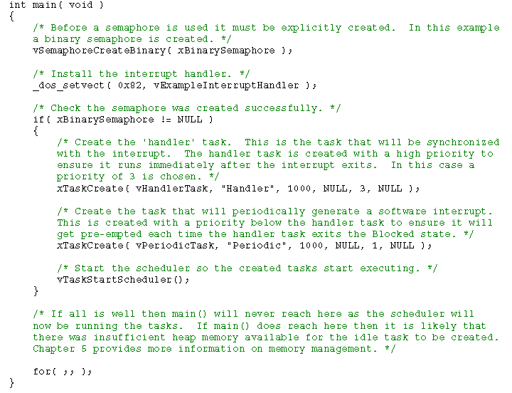
Example Main()

Slide 20
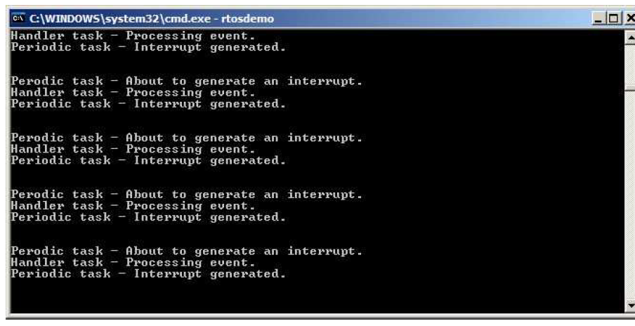
Example Output

Slide 21
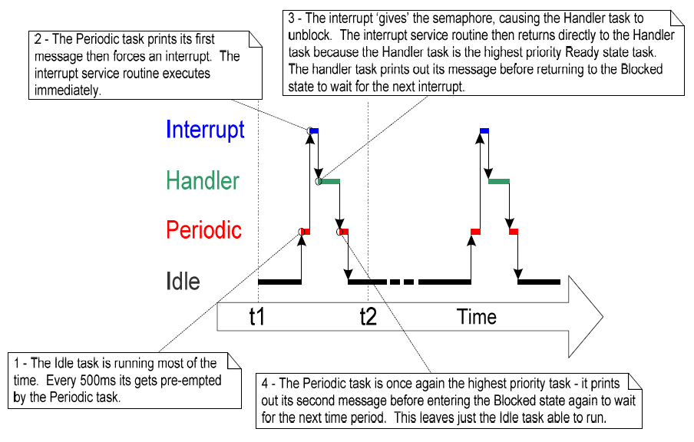
Example Code Flow

Slide 22
Counting Semaphores
A counting semaphore can take a number of ‘gives’ before a ‘take’ occurs
What happens if interrupts can occur at high frequency over a short period of time?
Counting Semaphore can be thought of a queue of n elements
A binary semaphore might get overrun as seen in the next slide

Slide 23
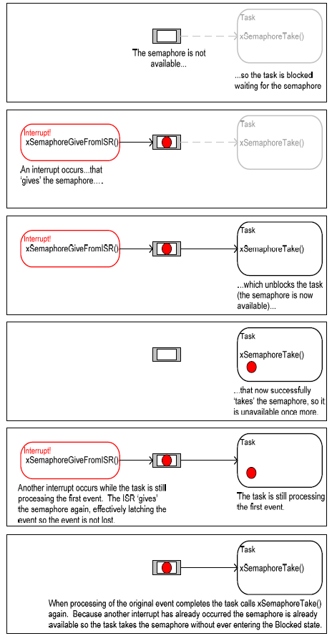
Limit of Binary Semaphore

Slide 24
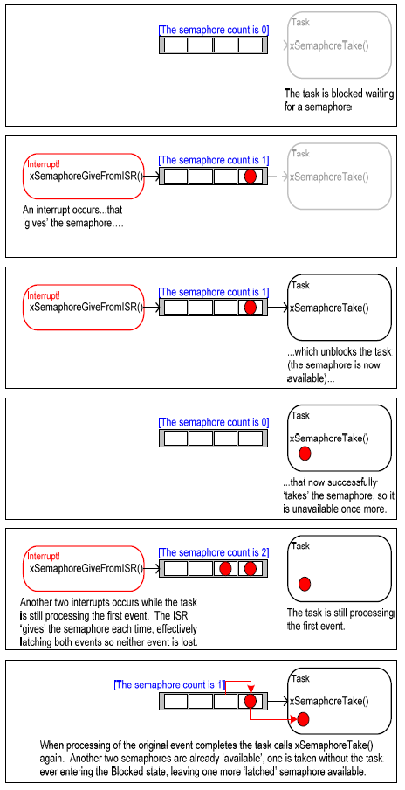
Counting Semaphore
Notes:
At the point that two interrupt events occur as in the 5 frame of the graphic the binary semaphore would be overwhelmed.

Slide 25
2 Ways to Use Counting Semaphore
Counting events
A semaphore is given each time an event occurs
A semaphore will be taken each time processing of the event occurs
The count is the difference between the ‘gives’-’takes’
Resource Management
Count represents the number of resources are available. To start, the number of semaphores = the number of resources. Every time a resource is taken a semaphore is taken, when done it is given back.

Slide 26
Creating a Counting Semaphore
Prototype
xSemaphoreHandle xSemaphoreCreateCounting(
unsigned portBASE_TYPE uxMaxCount,
unsigned portBASE_TYPE usInitialCount );
uxMaxCount: max number of semaphores in queue
uxInitialCount: Initial number of semaphores in queue
Return: Null or handle to the semaphore queue

Slide 27
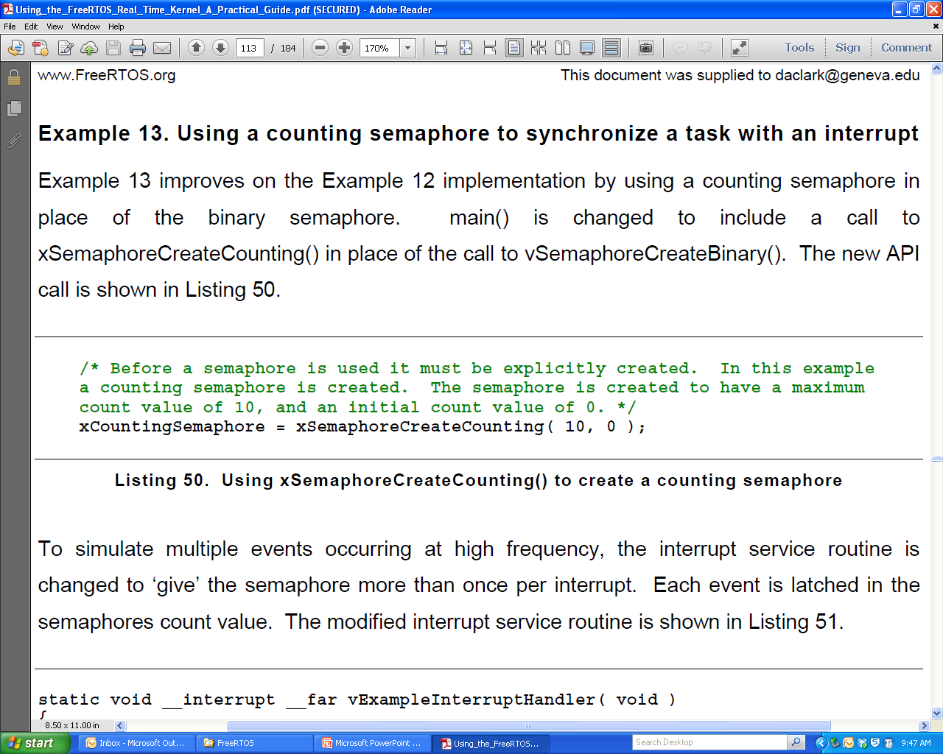
Counting Semaphore Example
This example uses the previous taking task and main (), just add the following to the main() code.

Slide 28
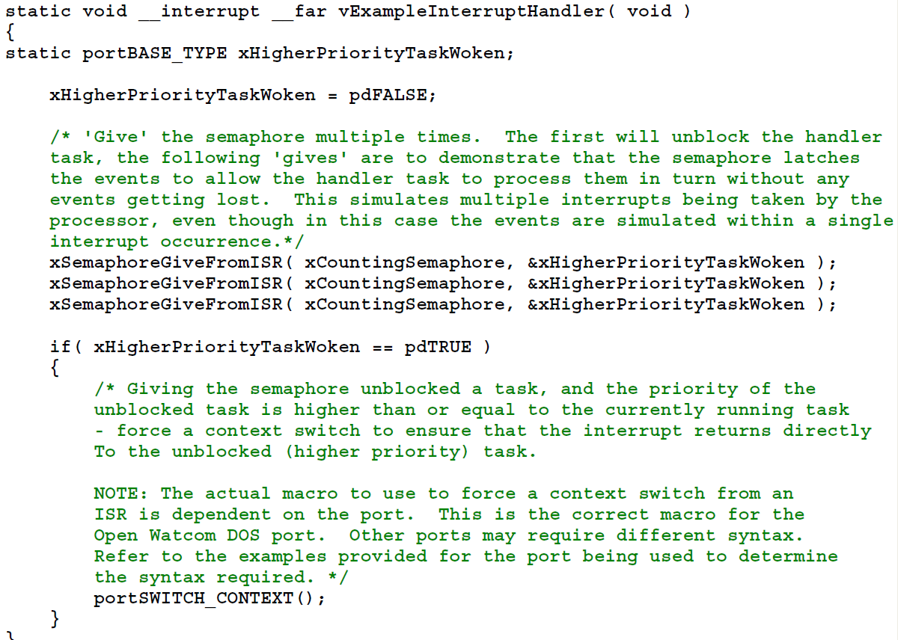
Example ISR
Notes:
Notice three gives in a row

Slide 29
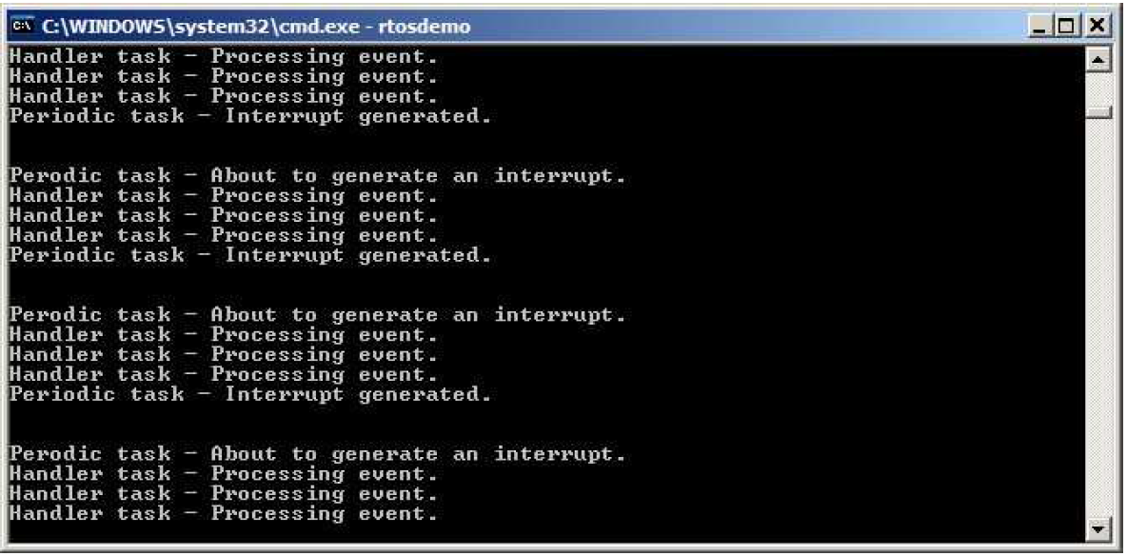
Example Output

